Slide 1
Hikoinga ngā Tapuwae
Walk in the Footsteps Fieldtrip

Slide 2
A Fieldtrip Resource
Step into history with this powerful half‑day field trip exploring key North Taranaki battle sites alongside expert guide and kaiako Hoani Eriwata (Te Atiawa).
Karakia
Tikanga is to recite a karakia before entering:
Hikoingia ngā tapuwae Tread upon the footsteps
Te ara o ngā tipuna The ancestral pathway
Te pā tūwatawata nei This is the defensive site
Te pakanga tuatahi The first anger
Tēnā koe e Te Kōhia That is you Te Kōhia
Huakiina! Open up!
Reminders for the day
Wear comfortable clothing and strong footwear
Bring sunscreen and hat
Familarise yourself with the pre-visit safety checklist
​

Slide 3
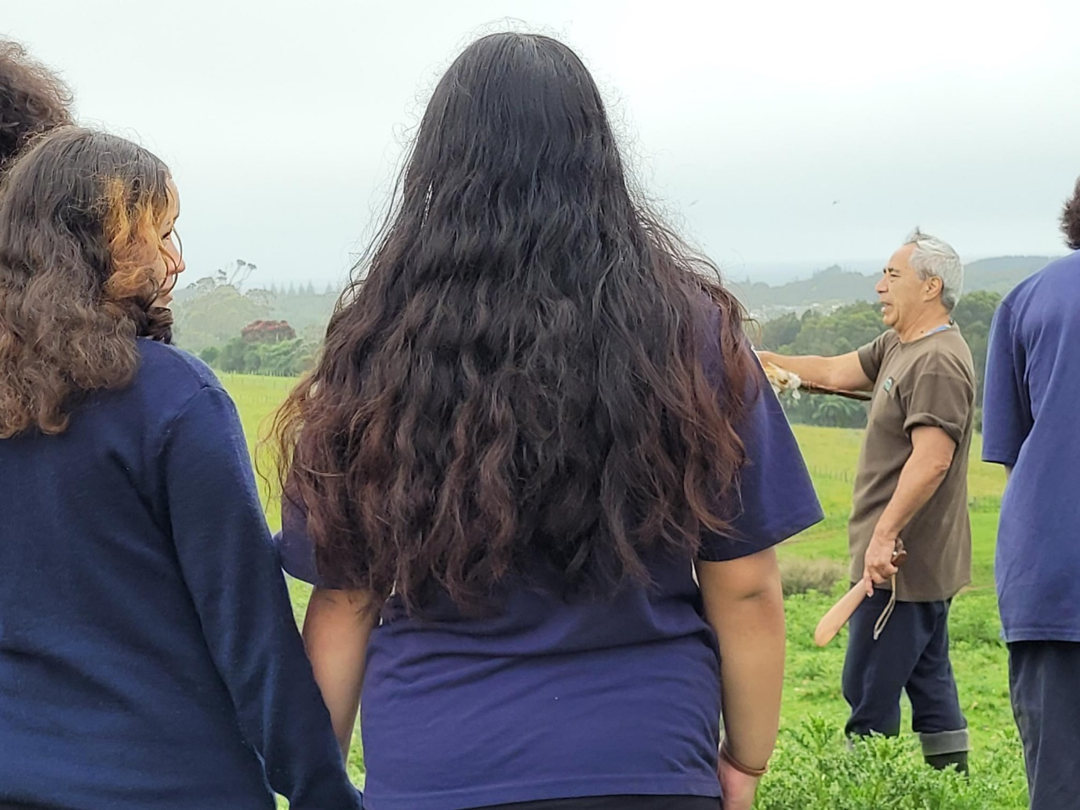
Hoani Eriwata
  Mātua Hoani is your guide who is from Te Ātiawa and is an experienced educator who supports ākonga in analysing the context of these historical events.
He helps students make meaningful connections between past and present—exploring how the legacies of these conflicts continue to influence people, communities, and the ways history is interpreted today.

Slide 4
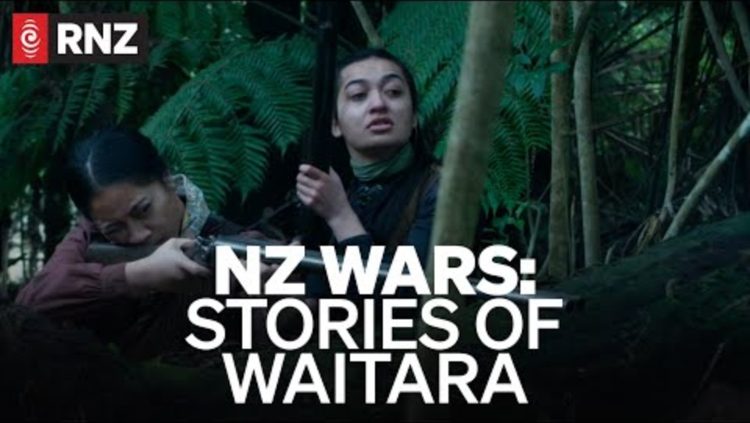
Prior to Visiting
Watch:
Familiarise yourself with the people and place will help you get the most out of your visit.
​

Slide 5
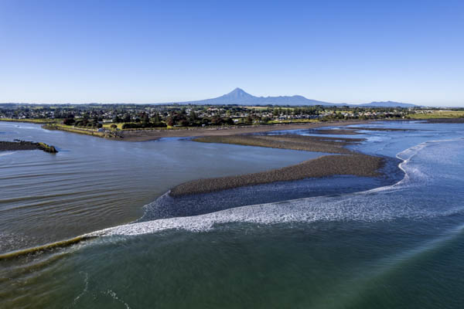
Waitara, and why it matters.
Waitara is a place where land, people, and history are woven together.
For Te Ātiawa, the whenua nourished both community and culture, fertile land beside a life‑sustaining awa.
Notes:
Teacher notes:
Looking at place first, Waitara is deeply connected to iwi identity, and is more than histories.
Student questions:
What makes a place important to people today?

Slide 6
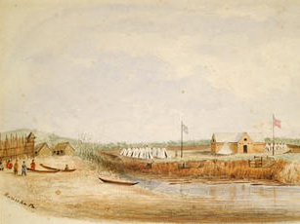
Setting the local scene: Prior to 1860
Relationships Before War
Early contact involved trade, co-operation and negotiations.
1840 – Te Tiriti o Waitangi signed
Over time, tensions grew as:
  Settler numbers increased rapidly
  Māori authority was sidelined in decision‑making
  The Crown failed to recognise collective ownership and Rangatira leadership
Notes:
Talking points:
Te Atiawa had thriving industry, and the settlers relied on their support very heavily. The whenua was highly fertile. Initially, Māori embraced the settler's arrival. They understood the economic benefits and quickly adjusted to help support the settler community who at the time were facing dire conditions.
Many settlers had come to Ngāmotu with hope, the New Zealand company has sold them an idealised version of life here.
Highlight the erosion of trust and decision-making exclusion
Critical questions
What was life like for Māori and Pākehā?

Slide 7
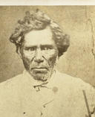
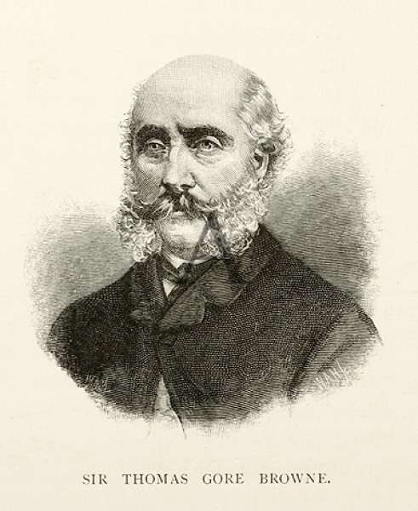
Clash of Worldviews
Māori and Pākehā brought different ideas about land, authority, and decision‑making.
Key Figure:
Rangitira, Wiremu Kīngi Te Rangitāke
Key figure:
Governor Thomas Gore Brown
Te Ātiawa perspective
  Whenua (land), Mother Earth, Papatūānuku is to be cared for as a collective, and inseparable from identity
  Rangatira authority (mana rangatiratanga) - generational leadership connected to care of people and whenua
Crown / settler perspective
  Land and resources treated as a commodity that could be bought and sold by individuals
  British sovereignty was assumed following the Treaty
Notes:
Critical questions
Critical questions
What does losing land mean beyond ownership?
How might these impacts compound over generations?
What does justice look like after harm has occurred?
How should historical sites be treated today?
Teacher notes

Slide 8
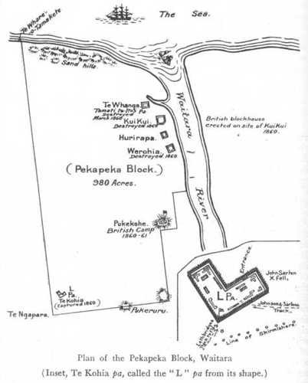
The Waitara land dispute
The Crown attempted to buy land without collective consent.
Wiremu Kīngi Te Rangitāke and Te Ātiawa opposed the sale.
The Crown’s refusal to halt the Waitara purchase signalled a breakdown in trust and dialogue.
This eventually lead to armed conflict between Te Atiawa and the Crown, beginning in Waitara.
Notes:
Critical questions
Who should have authority to sell land?
What does consent mean in a collective society?
Teacher notes
Link back to the clash of ideas between Pākeha and Māori - different worldviews, and British inability to acknowledge the Mana of Te Atiawa created the clash, that lead to warfare.

Slide 9
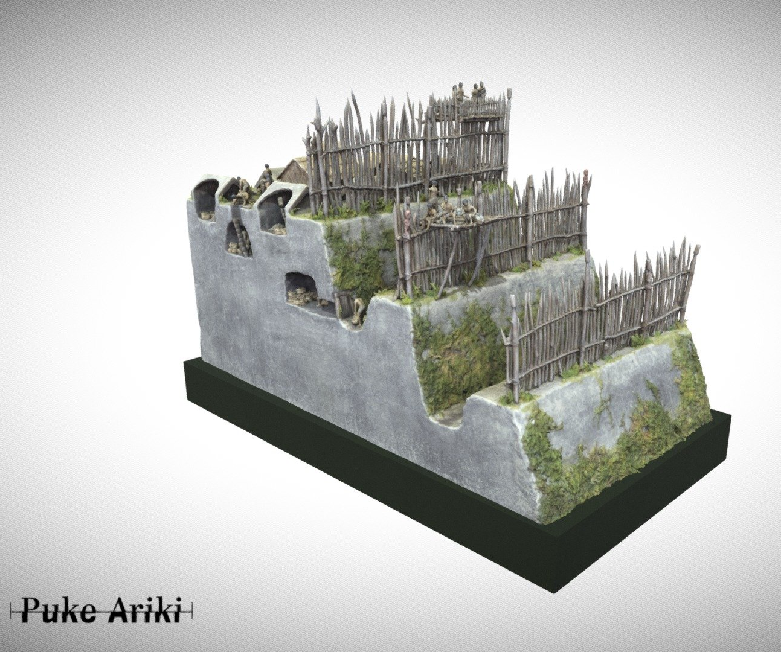
What is a Pā?
There are 4 key pā sites that are involved in the fieldtrip.
A pā is a fortified Māori settlement that served multiple purposes, including:
  Food cultivation and storage
  Communal activities
  Military defence
In the 1800s, pā were adapted to resist modern weapons.
Notes:
Teacher notes:
Frame pā as practical, strategic, and community‑focused.
Connect directly back to protecting whenua.

Slide 10
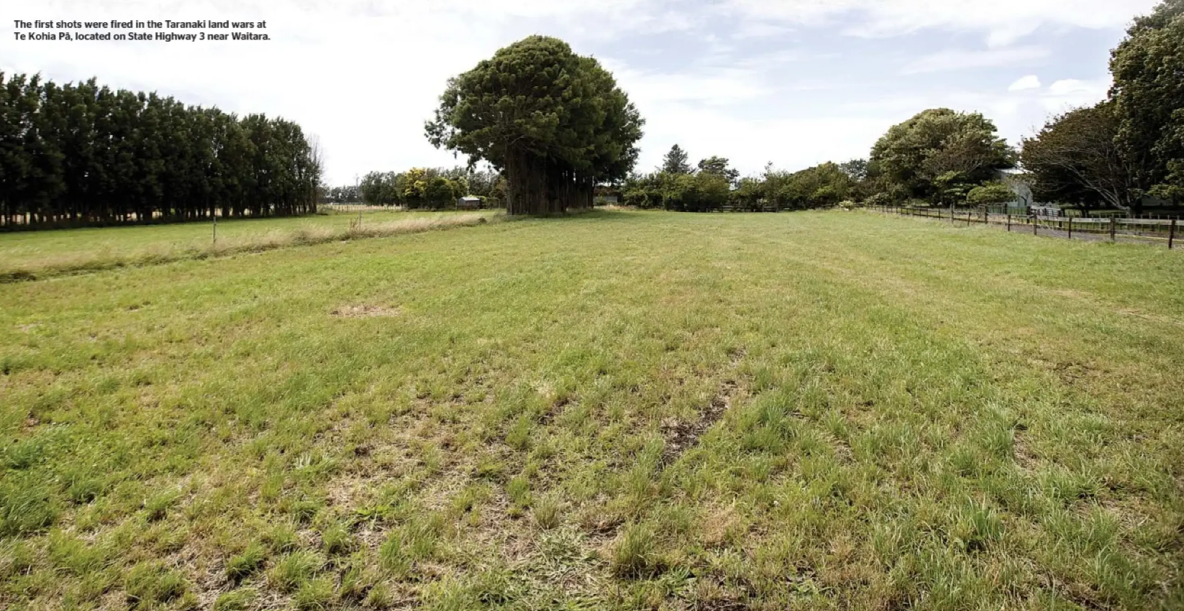
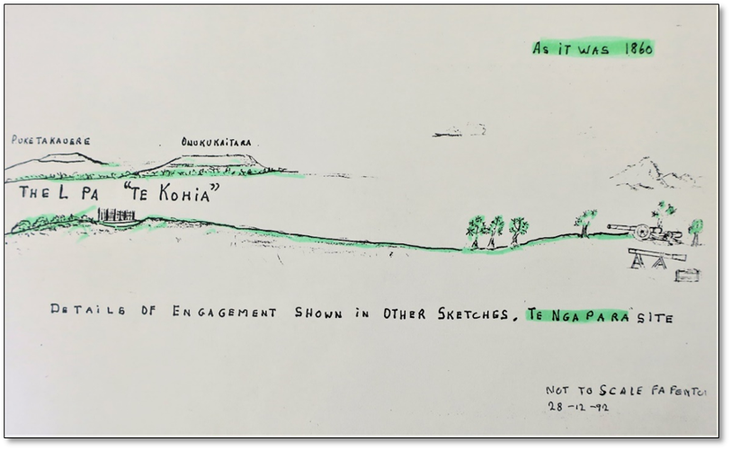
Site one on the fieldtrip
The First Shots: Te Kohia Pā
In March 1860, British troops attacked Te Kohia Pā at Waitara.
This was beginning of the armed conflict that would continue for 22 years around Maunga Taranaki.
Notes:
Critical questions
What message does military force send in a land dispute?
How might Māori have interpreted this action?
Teacher notes
Reinforce: the war starts as a choice by the Crown, not an accident
Link site to physical landscape students will walk

Slide 11
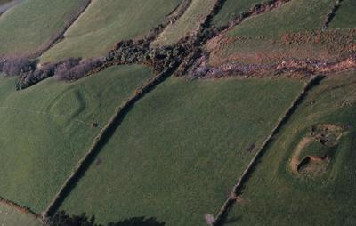
Puketākauere & Onukukaitara Pā
Puketākauere was a deliberately designed defensive site where Māori forces defeated British troops in 1860.
Strategy and knowledge of the land were crucial.
Site two on the fieldtrip

Slide 12
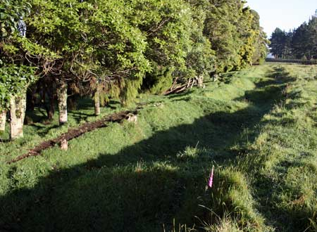
Pratt’s Sapp at Pukerangiora
Pukerangiora Pā overlooks the Waitara River and was a powerful stronghold of Te Ātiawa.
It became a key strategic and symbolic site during the wars.
A sap is a narrow trench dug by soldiers so they could move closer to an enemy position while staying protected from fire.
Site three on the fieldtrip

Slide 13
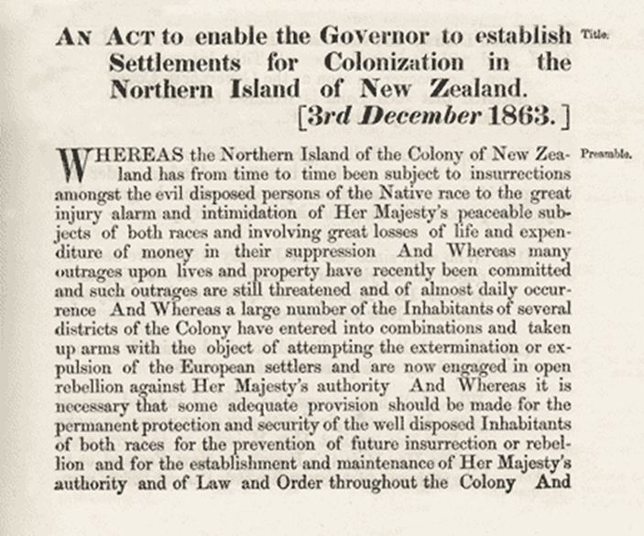
The Consequences: Loss of Whenua
Some of the consequences of the Wars:
Native Settlement Act 1863 – Māori deemed "rebellious" would lose their land without compensation.
Land confiscation (raupatu) devastated Te Ātiawa society; leading to the loss of economic, cultural, and political power still felt to this day.
The Te Atiawa Deed of Settlement 2014 – A formal acknowledgement and apology for the injustices suffered.
Notes:
Critical questions
What does losing land mean beyond ownership?
How might these impacts compound over generations?
What does justice look like after harm has occurred?
How should historical sites be treated today?

Slide 14
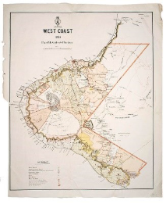
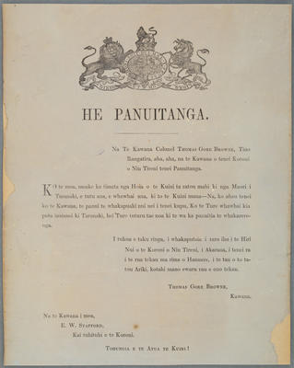
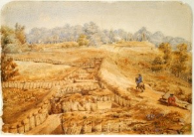
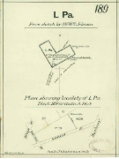
Puke Ariki Heritage collection items
Whose perspective do these objects reflect?
West Coast Plan of Confiscated Territory 1880 - Puke Ariki
Proclamations - Puke Ariki
L Pa Waitara [map] - Puke Ariki
"The Limit of the Sap at Te Arei" - Puke Ariki
Notes:
Reference base (for teachers)
Te Ātiawa Deed of Settlement – Summary
https://teatiawa.iwi.nz/wp-content/uploads/2025/10/Summary-of-Te-Atiawa-Deed-of-Settlement.pdf
Te Atiawa Claims Settlement Act 2016
https://www.legislation.govt.nz/act/public/2016/0094/latest
NZ History – Taranaki War 1860–63
https://nzhistory.govt.nz/war/taranaki-wars
Te Ara – Waitara
https://teara.govt.nz/en/1966/waitara

Slide 15
Waitara is not just a battlefield—it is a place of memory, resilience, and storytelling. Listening to multiple voices helps us understand the past more fully. Walking through these spaces, can help us to connect stories, places, and people.
As you walk these places, ask yourself:
“whose voices were heard, whose were ignored, and how does the land remember?”

Slide 16


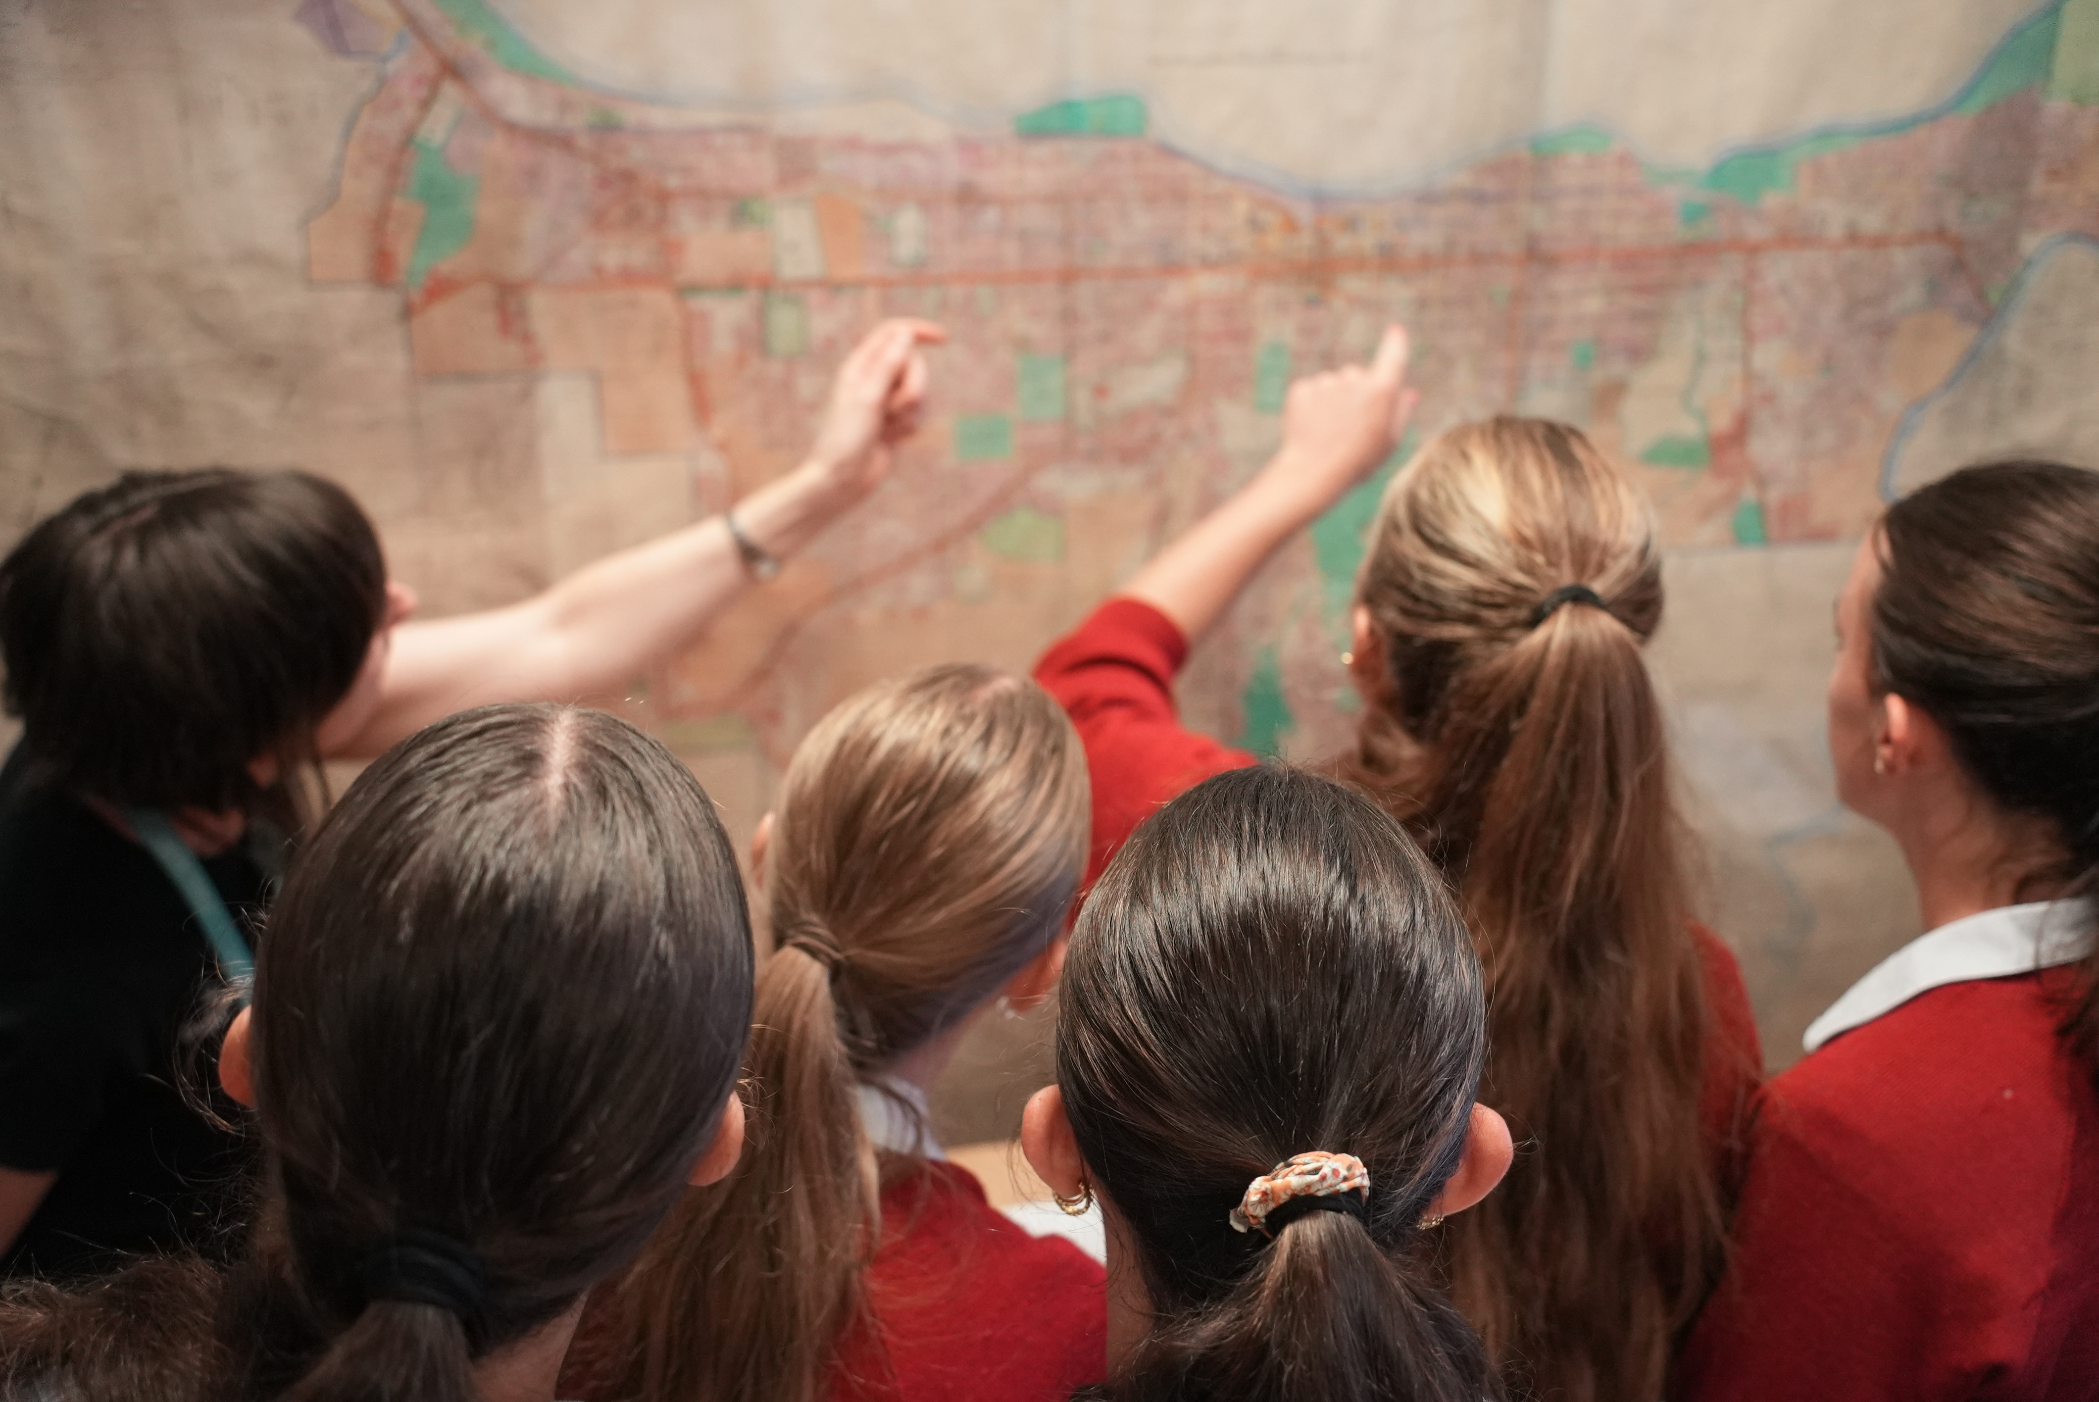

For other Museum sessions check out:
Uncover stories connected to Taranaki's history through the lens of Taonga, artifacts and archives in our Taranaki Wars lesson
Unlock the power of primary and secondary resources in our Te Pua Wānanga o Taranaki | Exploring the Research Centre lesson.
Otherwise, have a look at other learning opportunities:
Understand the story of Ngāti Te Whiti and the complexities of memorialisation with: Te Whare — TARANAKI CATHEDRAL

Slide 17
For more information and to book your next class visit – scan the QR code or go to miharo.com

