Slide 1



Get Creative with Len Lye

Slide 2
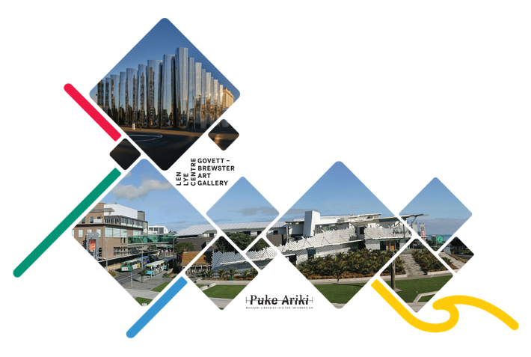

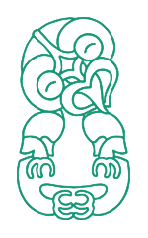
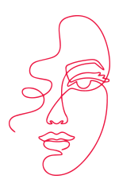
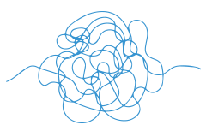
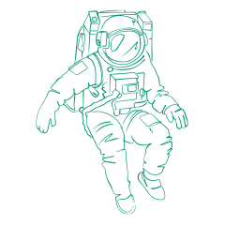

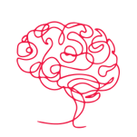
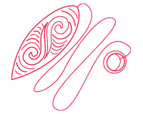

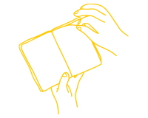
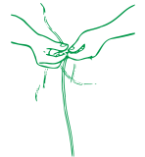



Meet The Team
Discover | Imagine | Create
Our team loves helping ākonga to connect with the stories of Taranaki through taonga, artworks, and hands on fun.
We’re here to spark your curiosity, encourage big questions, and support you to make your own creative connections across science, history, art, and more.
This resource is design to support your upcoming visit, we cannot wait to meet!
2

Slide 3

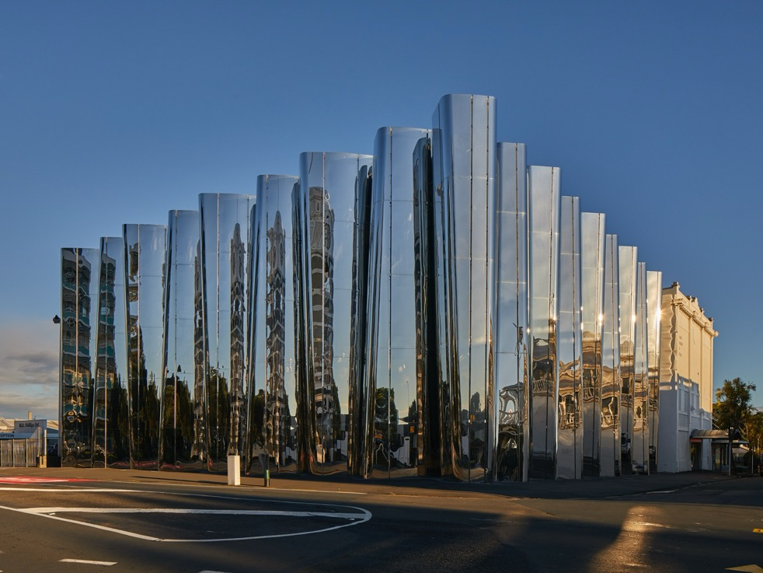
The Len Lye Centre
Yay!!! You're coming to visit the Len Lye Centre.
At the Len Lye Centre we store and display artworks by Len Lye and other artists.
The Len Lye Centre was designed to show art that surprises. Len Lye loved to use art to surprise himself and others.
3
Notes:
Add some questions and facts about the LLC. Opened in 2015. Len Lye said great art and architecture go together. What material is used on the outside of the building and why use

Slide 4
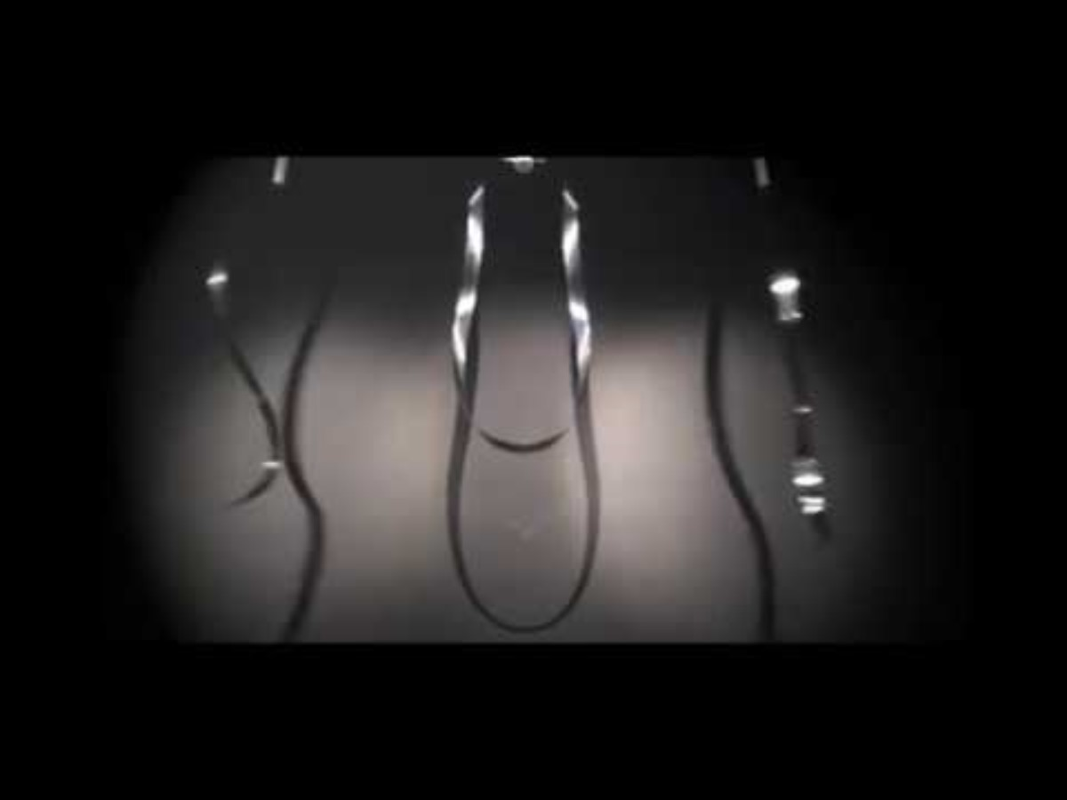

What is art?
Len Lye believed art could move, make noise, pop up anywhere, and that everyone is born with imagination. He tried all sorts of fun games and ideas to turn his thoughts into art and later shared them with his students.​

Slide 5
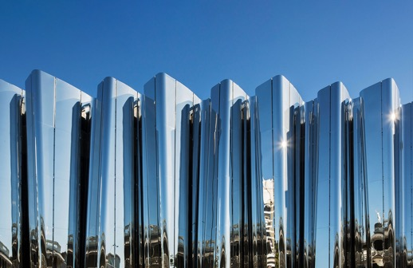
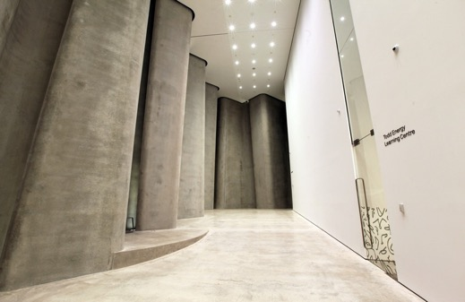

Surprise yourself!​
Make your finger wiggle like these walls.
Spread the wiggle (or is it a ziggle?) up your hand into your arm, then across your shoulders and down your other arm.
Pass your wiggle on to someone else for them to change and pass back to you. You’re becoming art!
The Len Lye Centre
5
Notes:
Add some questions and facts about the LLC. Opened in 2015. Len Lye said great art and architecture go together. What material is used on the outside of the building and why use

Slide 6
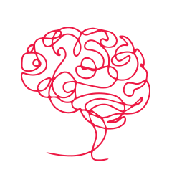
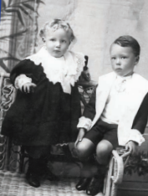
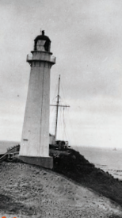

Who was Len Lye?
Len Lye was born in Lyttelton in 1901, and even though his family was happy, life got really hard when his dad died and he and his little brother had to move between relatives and foster homes.
Len and his little brother, Phillip.
Later they lived at Cape Cambell lighthouse, which Len loved — the huge storms, the sea, and the flashing light he called “The Great Flasher” filled his imagination and helped inspire the moving, light‑filled art he made as an adult.
6

Slide 7
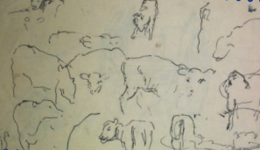
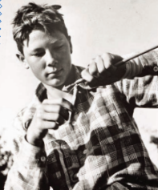
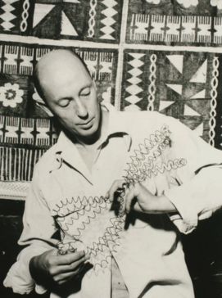
When the family had to leave the lighthouse, Len missed it a lot, but he discovered drawing, and he sketched everything he could. This is when his mum told him he might grow up to be an artist.
Len started making art when he was a kid, just like you, and he loved using all his senses to explore the world.
Len Lye completed many forms of artworks over his life.
When he passed on 15th May 1980, he left an amazing legacy for us all to discover and enjoy.
Len Lye
New York, 1968
7

Slide 8
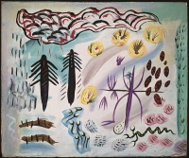
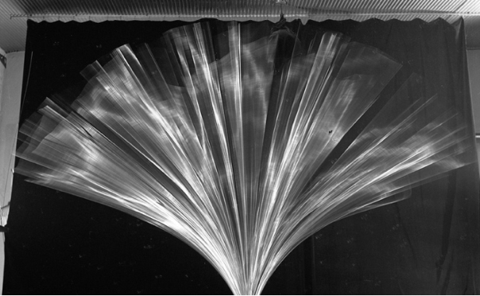
Get creative
How do you get ideas?
First, open your mind. In the world of art anything is possible.
Even mistakes are a great source of inspiration.
Do! Just trust the artist inside you and start doing.
Len used sense games and activities to help his imagination flow. He believed that having lots of fun trying things out was key to becoming an artist. ​
You do: Mystery noise
Make a sound using only your hands, mouth, or body — a snap, a pop, a hum, a whistle — and have them guess how you made it. Then it’s their turn. Simple to start, surprisingly tricky once you get inventive.
8

Slide 9
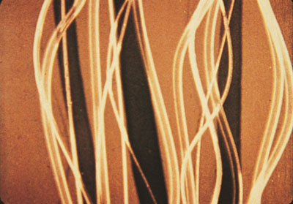
Experiment!
Len experimented with many different ways to turn his ideas into art.
Drawing, painting, film-making, photography without cameras, moving sculptures, writing, dancing.
Each page of this resource focuses on one type of art but Len didn’t think that way. His ideas crossed over from one thing to another.
9

Slide 10
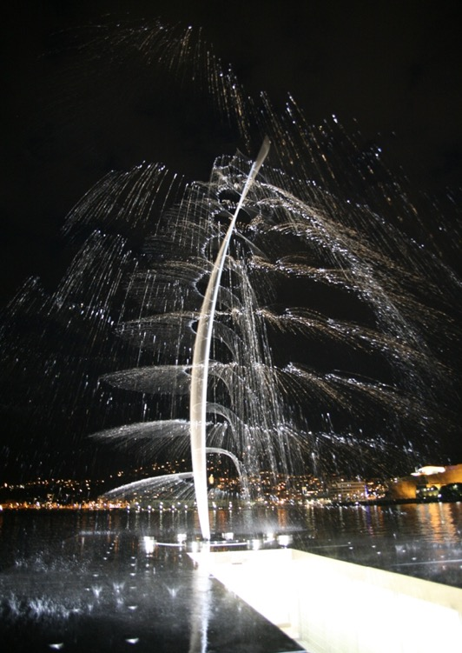
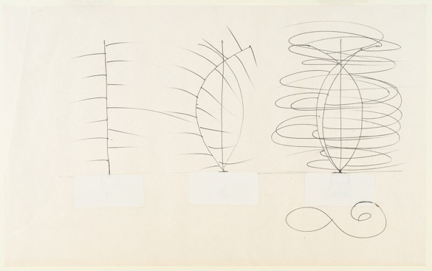
How is sculpture different from other types of art?
Mak​ing sculpture can be very tricky! Here is a sculpture in Wellington called Water Whirler.
What problems might need to be solved to make a sculpture like this? ​
​
Here is a sketch made by Len, planning how the sculpture would work.
How do you think science
helped Len Lye make sculpture?​
​
10

Slide 11
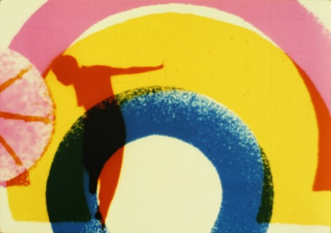
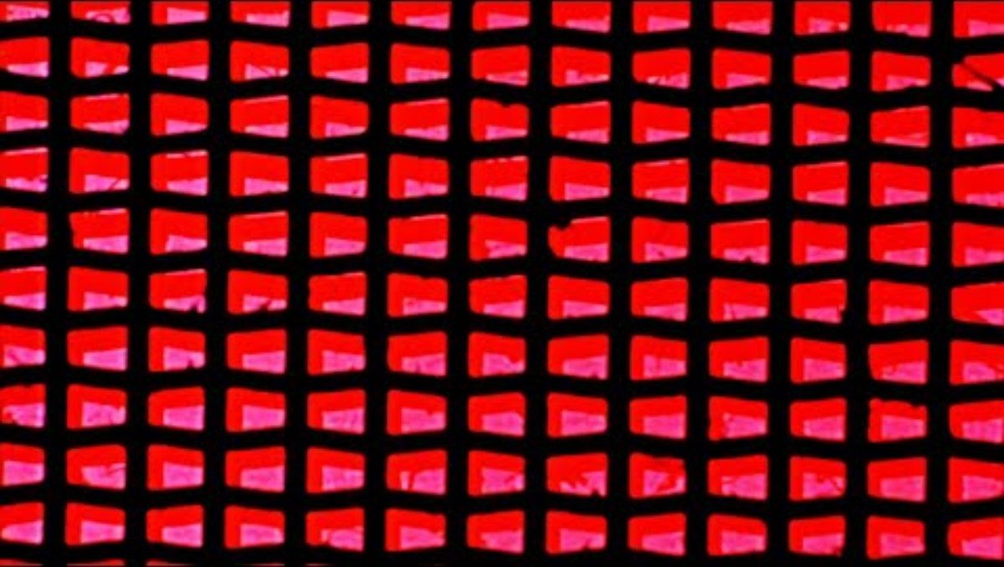
What do you know
about animation?
Here is one of Len’s movies
How do you think the animations work?​
​
How do the pictures and sounds in Len’s
movies work together?​​
What is different about Len’s movies
compared to a 'normal’ movie? ​
11

Slide 12
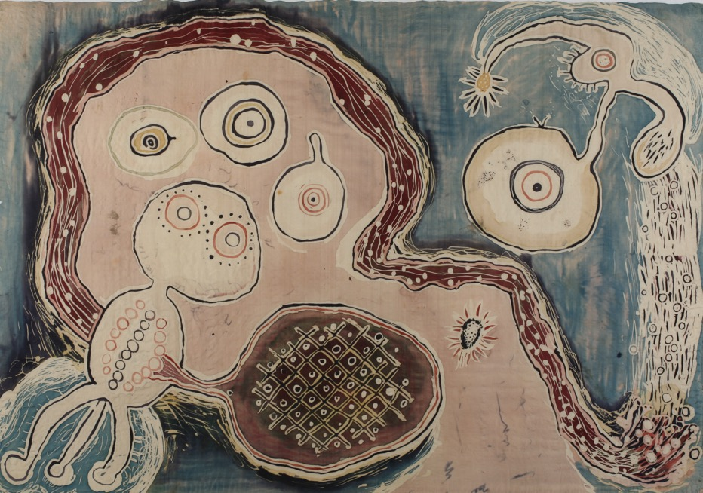

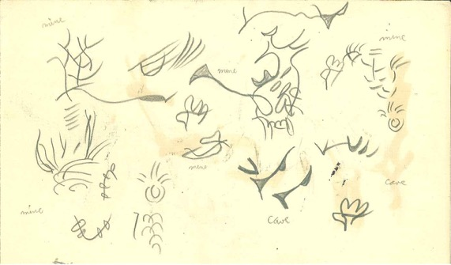
Nature Inspired​
Len Lye created art about nature such as life cycles, space, water cycles, amoeba, and wave action.
What creative ways to draw have you tried?
We experience nature through our 5 senses.​
Draw this sound from nature.
​In this batik painting and drawing you can see how Len wasinspired by nature.
12

Slide 13
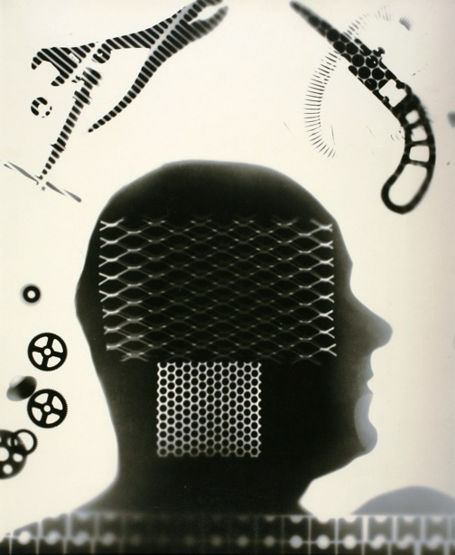
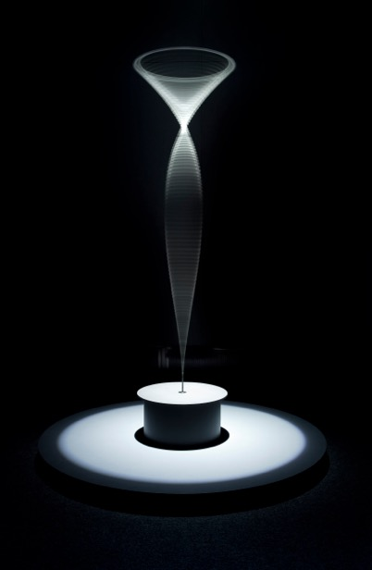

Light and Dark​
Here Len uses light and dark to create 3D form
What ways can you show light and shade using a pencil?
Try shining more than one torch on an object.
What do you notice about the shadows?
What patterns of light can you see on the water?
13

Slide 14
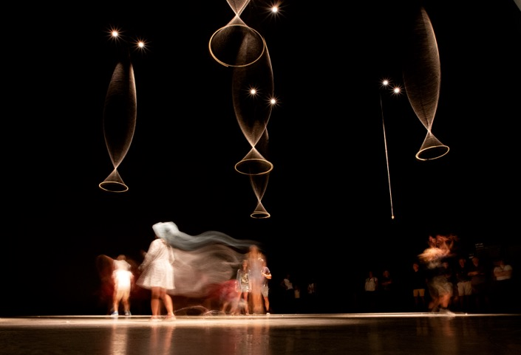
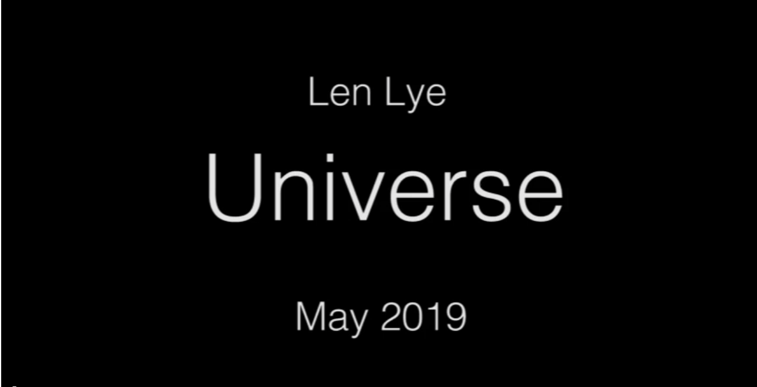
Dance, sound and word ideas ​
Len was inspired by sound and movement in the world around him.
What can you use to inspire your own dance moves?
What sounds could you use for this artwork?​
Play this clip on mute:
What sounds do you think are involved?
Len loved playing with words.
Replay with sound now and see if
your sounds are similar.
Invent some new words!
What do they describe? WOMP! ​
14

Slide 15
Teacher notes
Sculpture
Len Lye is well known for his moving (kinetic) sculptures. You can find his Wind Wand on Ngāmotu New Plymouth’s coastal walkway. Many of his other kinetic sculptures may be experienced at the Len Lye Centre. Their names give clues to Len's source of inspiration - nature ; Wand Dance, Universe, Storm King, Fountain, Fire Bush..Len said "My work is going to be pretty good for the 21st century...[because] I don't think there'll be the means [until then] to have what I want, which is enlarged versions of my work".
Movies
Len loved movement and took up film making as a way to express this. He used the traditional hand-drawn animation technique for his first movie called Tusalava which took a long time to make and was expensive. So for his next movie called Colour Box he invented a new way of making movies without using a camera. He painted images directly onto the strips of plastic film so it was called a ‘direct’ film. People were amazed by its bright colours, jazzy music and powerful vibe. He’d invented the first version of a music video!
Drawings and paintings​
Len learnt how to draw ‘reality’ which helped him look hard at the world and wonder about it. But he wanted to try other ways to experiment with mark making. He tried the Exquisite Corpse game, sense games, doodling from his ‘old brain’, drawing blindfolded, drawing using nature (sticks, sand , flowers).​
Len used his drawings to create imaginative paintings. He invented mythical creatures living in watery or unknown worlds. He used amazing colours and sometimes dye and wax to tell old stories in new ways.​
Light and dark
Len got creative with light and dark to make some of his art. His sculptures are very shiny so they make amazing reflections that zap out of the darkness. They also make shadows that overlap and are different shades.
Len also used light and dark to make photographs without using a camera called photograms. This type of photo captures the shadows of objects that do different things to light; transparent (lets light through), translucent (lets some light through), opaque (stops all light), reflective (light bounces off).
Dance, sound and word ideas
Len loved getting creative with all parts of life. He loved inventing his own dance moves, experimenting with sound, and making up new words.​ Some of Len’s dance moves were inspired by, for example, watching a cat stretch out and feeling that stretch in his own body. Some of his favourite sounds came from the rhythms of nature or jazz music. Len enjoyed putting words together in surprising ways and using them in his poems. ZIGGLE, vizzy-vozzy, and drumming that rattles the marbles in your skull.​
15

Slide 16
New Zealand Curriculum alignment:
Science: | Physical Science | A focus on energy, forces and motion. Developing understanding of how physical systems behave and interact. Using scientific reasoning and modelling to explain and predict phenomena.
Mathematics and Statistics: | Algebra | Developing understanding of how patterns and relationships can be represented using symbols, graphs, and diagrams, and how algebraic thinking supports communication.
 | Geometry | Focusing on shape, space, and transformation. Developing understanding of how to visualise represent, and reason about objects and their position, orientation, and movement, drawing on geometric ideas used across cultures and contexts.
Social Sciences: | History | Interpreting the past through significant events, cultures, and changes over time. Developing understanding of how historians use evidence and concepts to explain how societies have developed.
The Arts: | Performing Arts | Expressing and interpreting meaning through movement and performance. Exploring identity, emotion, and storytelling connects communities, preserves traditions, and inspires innovation.
 | Music | Understanding and expressing meaning through sound. Learning through improvisation, experimentation, and repetition, and engaging with music from diverse times and cultures.
 | Visual Arts | Teaching students to explore and communicate meaning through visual forms. Developing understanding of creative processes, visual conventions, and how to express ideas with intention.
16
Notes:
Add some questions and facts about the LLC. Opened in 2015. Len Lye said great art and architecture go together. What material is used on the outside of the building and why use

Slide 17

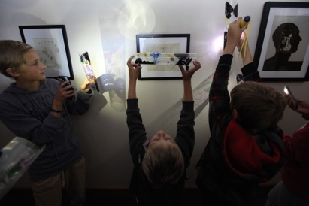
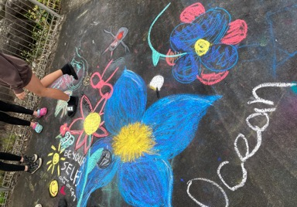
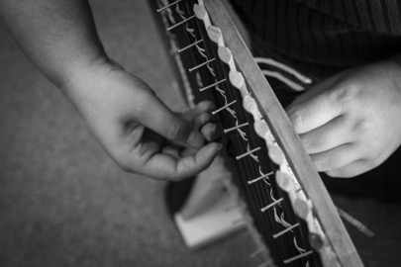
For our Gallery sessions check out:
Ākonga experiment with light, colour, and materials to create striking artworks in a hands-on makerspace experience.
Ākonga uncover the stories of New Plymouth’s street art on a mural tour, then create bold, environmentally themed chalk artworks of their own.
Create your own learning journey by combining this lesson with other programmes in our pick‑your‑path experience.
Discover tukutuku patterns, and their links to culture, identity, storytelling, mathematics and whakapapa in this hands-on Library lesson.
17
Notes:
Add some questions and facts about the LLC. Opened in 2015. Len Lye said great art and architecture go together. What material is used on the outside of the building and why use

Slide 18

For more information and to book your next class visit – scan the QR code or go to miharo.com

