Slide 1

Tukutuku I Lattice Panels

Slide 2

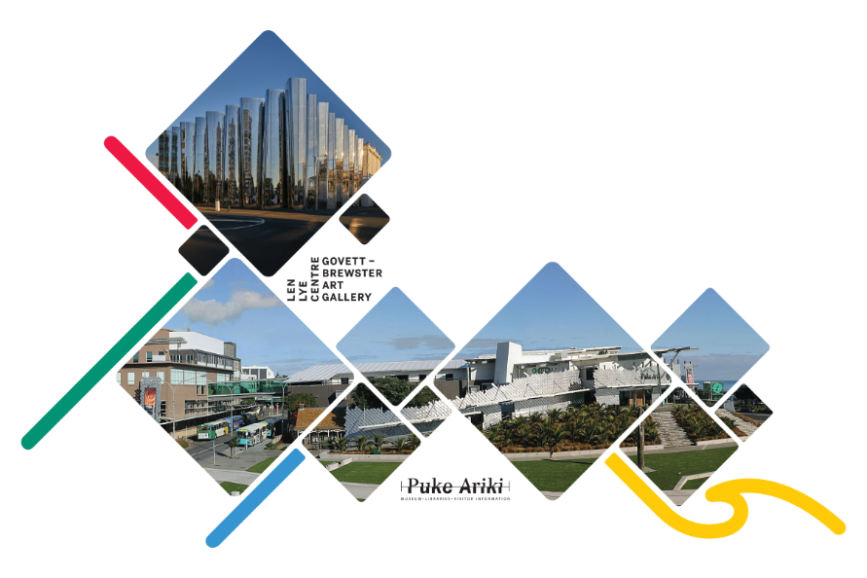

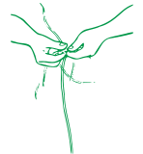
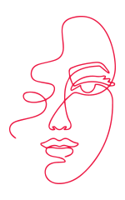
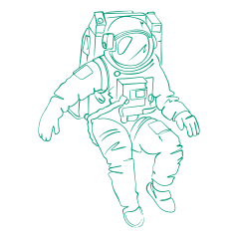



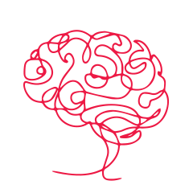
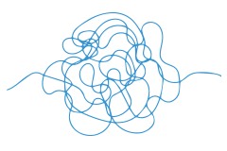
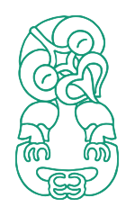

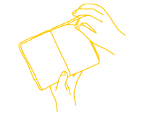

Meet The Team
Discover | Imagine | Create
Our team loves helping ākonga to connect with the stories of Taranaki through taonga, artworks, and hands on fun.
We’re here to spark your curiosity, encourage big questions, and support you to make your own creative connections across science, history, art, and more.
This resource is design to support your upcoming visit, we cannot wait to meet!

Slide 3
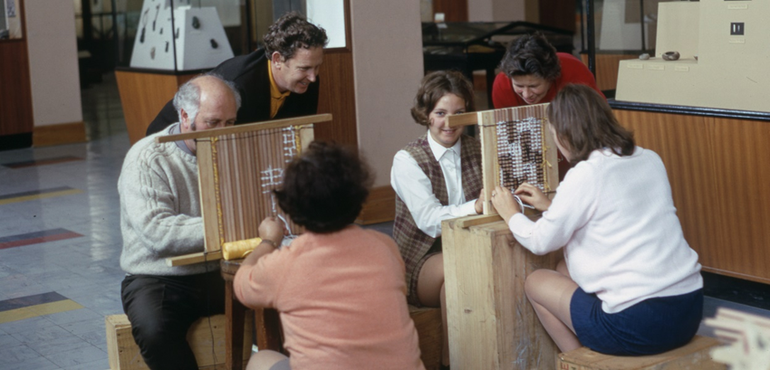
Rigby Thomas Ewen Allan (1969), collection of Puke Ariki PHO2011-0598
What stories might tukutuku designs tell?
Tukutuku patterns can be different for each iwi across Aotearoa. Some patterns belong to specific iwi, while others may have different names or spellings in different areas. Many tukutuku patterns are connected to traditional stories and beliefs, and these stories can change depending on the iwi sharing them.

Slide 4

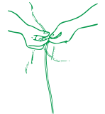
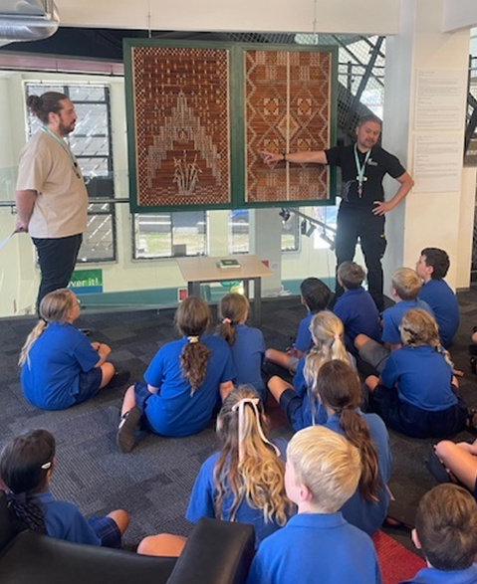
Puke Ariki Library
You are coming to visit Puke Ariki Library.
Your mission is to explore and examine Taranaki’s unique heritage through the tukutuku on display here.
Tukutuku are also known as arapaki. Traditional tukutuku designs are likes code.
Using hands-on activities, you can try cracking the code to find the meanings behind the patterns, then design your own!
These panels were made by Kim Kahu, made at Te Wananga o Aotearoa, 2009.
4

Slide 5
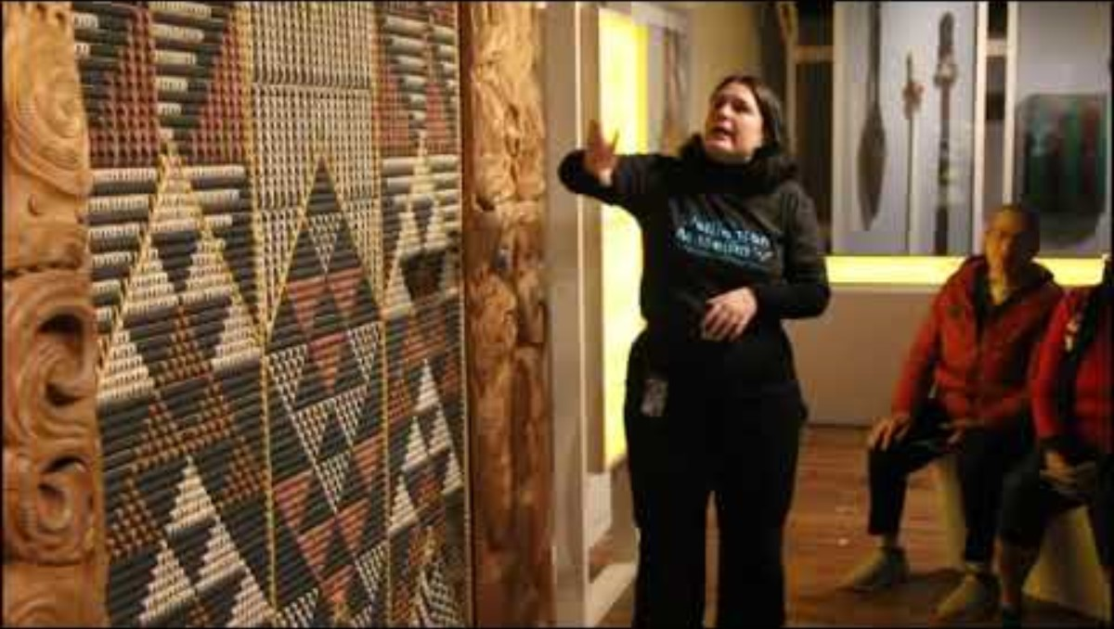

Tukutuku described by a Museum Curator

Slide 6
Puke Ariki Library panels decoded
I Neherā
What can you see in this tukutuku panel?
The top of the panel shows stars, representing your whānau across time, connecting people from the past to those here today.
Below are a rainbow of books, the rainbow represents hope and youth.
Below is the poutama or stairway, representing the Taranaki Maunga and the journey of learning.
The bottom of the panel is the harakeke plant, that represents whānau and the whenua.
Kim Kahu, Te Whare Wananga o Aotearoa, 2009

Slide 7
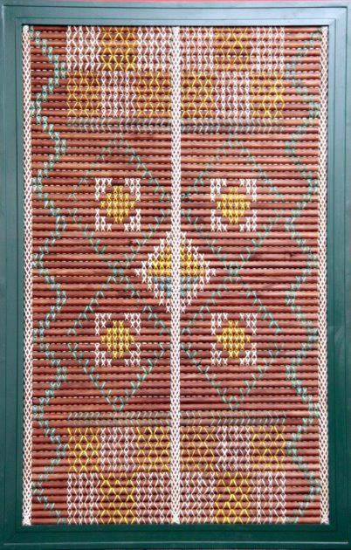
Puke Ariki Library panels decoded
Manawhenua
.
This panel depicts Ngā Hau e Whā, the 4 winds of Tāwhirimātea.
What can you see in this panel?
The top of the panel is represented by the Mumu design, which stands for tribal alliances and marriage.
The Pātikitiki design in the centre of the panel means to be able to provide for the whānau and iwi.
The border shows the whenua landscape.
Kim Kahu, Te Whare Wananga o Aotearoa, 2009

Slide 8
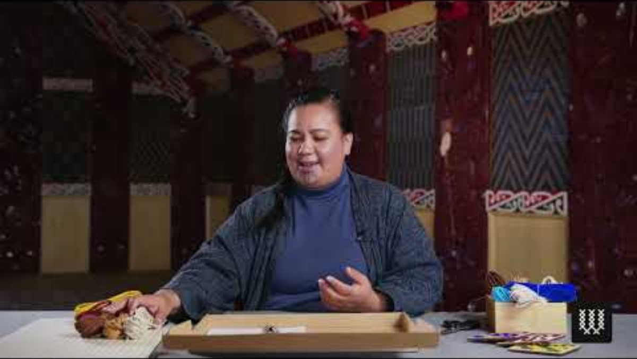
Starting your own Tukutuku

Slide 9
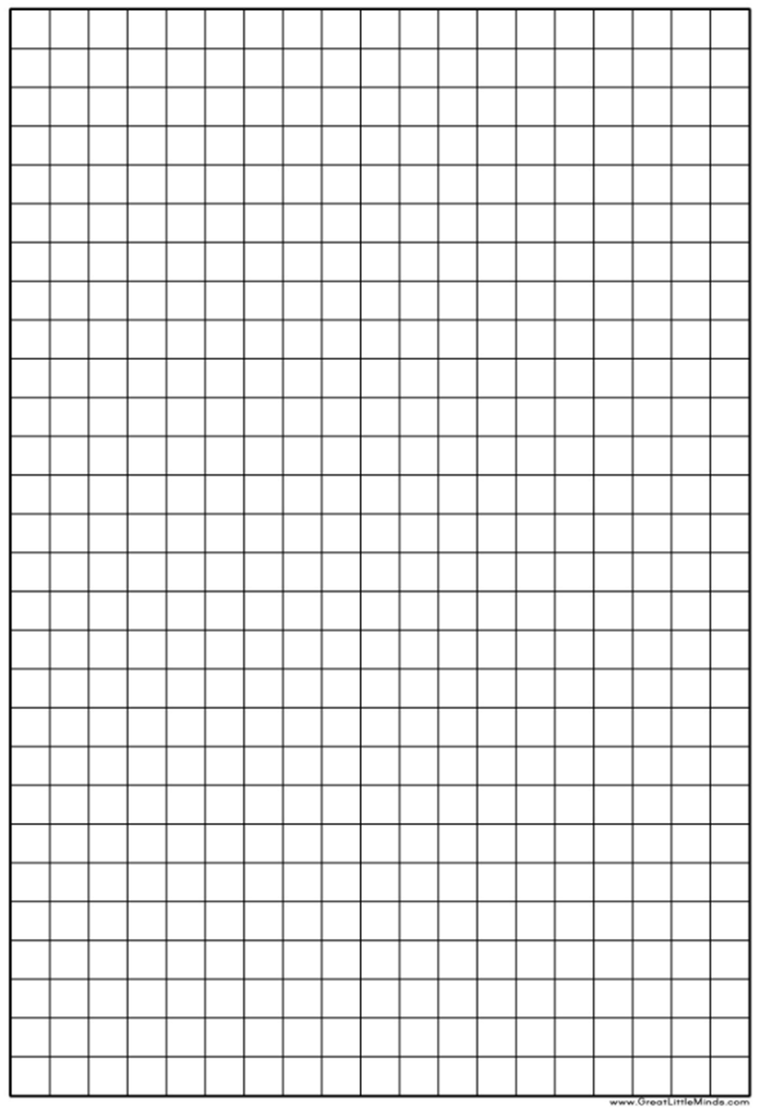
Geometry Task
This is a maths task that uses shape and transformation.
Follow these steps to create your own design:
Step 1. Draw a simple shape like a line, cross, or a zig-zig on your page
Step 2. Use transformation to create your design
REFLECTION – Flip your shape like mirror​
ROTATION – Turn your shape to face a new direction​
REPETITION – repeat it again and again to create your pattern

Slide 10
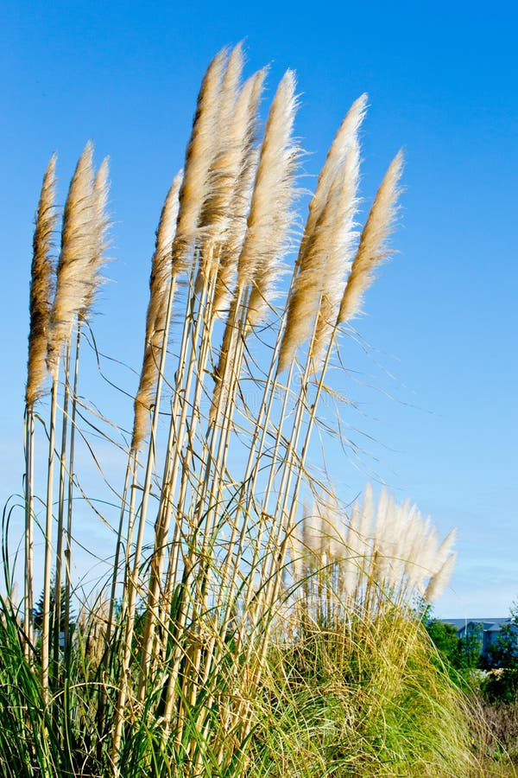
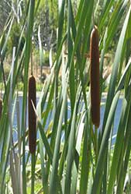
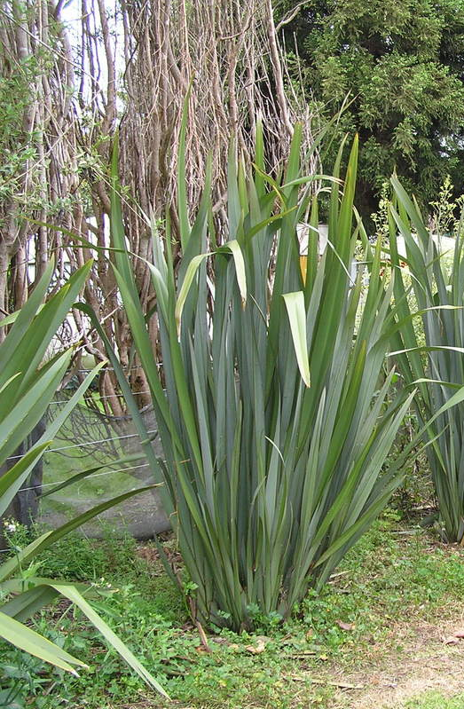
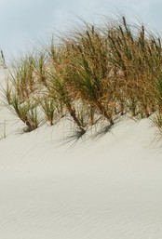
Natural materials used to make Tukutuku
Toitoi
Raupo
Toitoi is used for the back part of the panels. It is a native plant found in the wetlands and coastal areas, providing important habitat for native wildlife.
Used for the front part of
the panels. Also known as bullrush, the raupo is a wetland plant growing up to 4 m tall. These inhabit swamp lands in and around sheltered lakes and ponds.
Harakeke
Pīngao
Used for patterning, harakeke is unique to New Zealand and is one of our most ancient plant species. It supports wildlife by providing shelter and large food source.
Used for patterning, pīngao is a grass-like plant, 30–90 cm tall, found on sand dunes. It is found only in New Zealand and is easily distinguished from other species that grow on sand dunes.

Slide 11

Teaching Resources
Pg.8. Geometry task:
Shape: Classify plane shapes
Position and Orientation: Positions relative to each shape/pattern
Transformation: Reflection, Rotation, Repetition
NB: This particular pattern shows the patikitiki or flounder (representing sustainability)
Task: Have students draw a pattern on a grid paper to create a full panel
Web links
https://my.christchurchcitylibraries.com/puawaitanga-o-te-ringa/the-tukutuku-panels/
https://www.youtube.com/@whatucreative
https://teara.govt.nz/en/interactive/43489/types-of-tukutuku-designs
https://www.whatucreative.com/products/tukutuku-toi-kit-mini-natural
Books
Arapaki: Warming the Marae / Whakamahana i te Whare, by Doreen Bennett, Te Atawhai o te Ao Charitabke Trust, 2022
Talking Tukutuku, by Kirsty Wadsworth, to be released Sept. 2026

Slide 12
New Zealand Curriculum alignment:
Technology | Design, make and innovate | Focus on the design processes and making simple outcomes. Developing understanding of how ideas are explored, tested, and refined to meet needs and how design affects people and the environment.
English | Oral language | Teaching students to communicate, express themselves, and interact effectively. Developing understanding of spoken communication.
 | Reading | Students decode, make meaning from, and think critically about visual and narrative texts.
Mathematics and Statistics | Algebra | Developing understanding of how patterns and relationships can be represented using symbols, graphs, and diagrams, and how algebraic thinking supports communication.
 | Geometry | Focusing on shape, space, and transformation. Developing understanding of how to visualise, represent, and reason about objects and their position, orientation, and movement, drawing on geometric ideas used across cultures and contexts.
Social Sciences: | History | Interpreting the past through significant events, cultures, and changes over time. Developing understanding of how historians use evidence and concepts to explain how societies have developed.
The Arts: |  | Teaching students to explore and communicate meaning through visual forms. Developing understanding of creative processes, visual conventions, and how to express ideas with intention
12

Slide 13
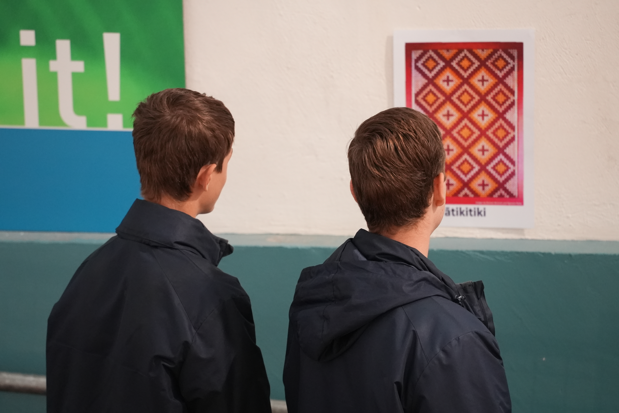

Meet the Miharo team – your group is welcomed by Miharo staff in
the library foyer.
2. Move through the space – students walk along the Level 2 ramp to Discover It!, observing and remembering the 8 tukutuku pattern cards.
3. Group activity – in small groups, students match pattern cards with their correct names using provided folders.
5. Gather and reflect – Miharo staff guide a discussion, unpacking the meanings of the patterns and how the names connect to their stories and cultural significance.

Slide 14

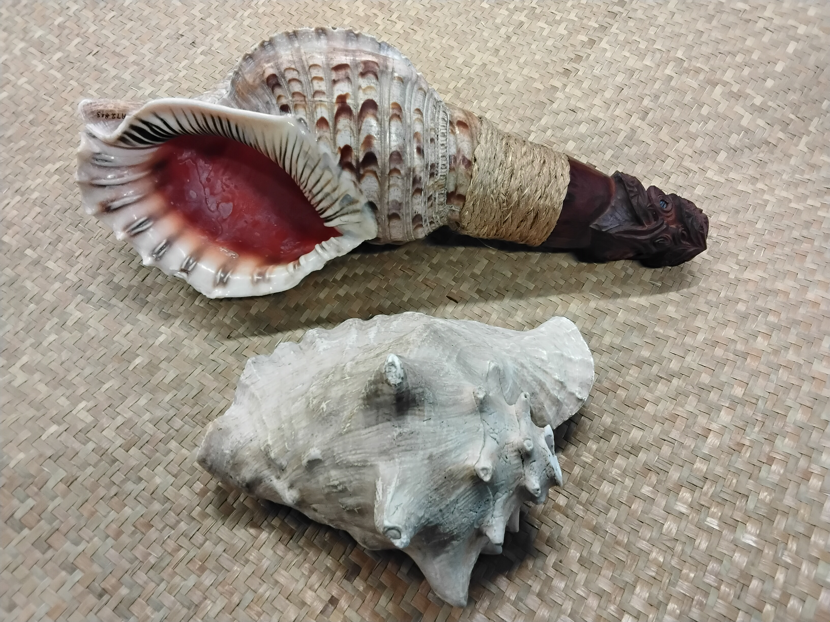
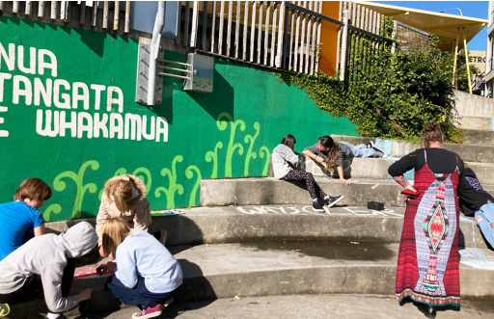
Create your own learning journey by combining this lesson with other programmes in our pick‑your‑path experience.
Discover taonga pūoro connect to culture, storytelling, and the natural world in this hands-on Museum lesson
Ākonga uncover the stories of New Plymouth’s street art on a mural tour, then create bold, environmentally themed chalk artworks of their own.
14

Slide 15
For more information and to book your class:
Notes:
Here are some general notes that answer our lesson’s key questions and some suggested resources to support further learning.
Web links
https://my.christchurchcitylibraries.com/puawaitanga-o-te-ringa/the-tukutuku-panels/
https://www.youtube.com/@whatucreative
Book
Arapaki: Warming the Marae / Whakamahana i te Whare
Doreen Bennett, Te Atawhai o te Ao Charitabke Trust, 2022

